Slide 1
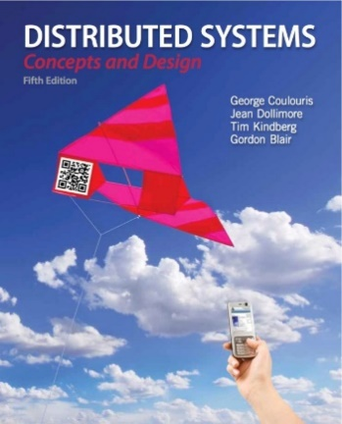
Distributed Objects Programming
- Remote Invocation
Rajkumar Buyya, Maria Rodriguez Sossa
Cloud Computing and Distributed Systems (CLOUDS) Laboratory
School of Computing and Information Systems
The University of Melbourne, Australia
http://www.cloudbus.org/652
Most concepts are
drawn from Chapter 5
©Addison-Wesley 2012.

Slide 2
Outline
Exchange Protocols
Remote Method Invocation
Remote Procedure Call

Slide 3
Introduction
We cover high level programming models for distributed systems. Two widely used models are:
  Remote Procedure Call - an extension of the conventional procedure call model
  Remote Method Invocation - an extension of the object-oriented programming model.
Applications
Remote invocation, indirect communication
Middleware
Underlying interprocess communication primitives:
layers
Sockets, message passing, multicast support, overlay networks
UDP and TCP

Slide 4
Request-Reply Protocol
Exchange protocol for the implementation of remote invocation in a distributed system
We discuss the protocol based on three abstract operations: doOperation, getRequest and sendReply
Client
Server
doOperation
Request
message
getRequest
select object
(wait)
execute
Reply
method
message
sendReply
(continuation)

Slide 5
Request-Reply Operations
public byte[] doOperation (RemoteRef s, int operationId, byte[] arguments)
  Sends a request message to the remote server and returns the reply
  The arguments specify the remote server, the operation to be invoked and the arguments of that operation
public byte[] getRequest ()
  Acquires a client request via the server port
public void sendReply (byte[] reply, InetAddress clientHost, int clientPort)
  Sends the reply message reply to the client at its Internet address and port

Slide 6
Typical Message Content
A message in a request-reply protocol typically contains a number of fields as shown below:
messageType
int (0=Request, 1= Reply)
requestId
int
remoteReference
RemoteRef
operationId
int or Operation
arguments
array of bytes

Slide 7
Failure Model
If operations are implemented using UDP, then they suffer from the same communication failures:
  Lost messages
  Out of order
In addition, the protocol can suffer from the failure of processes (crash failures)

Slide 8
Design Issues
Fault tolerance measures we can consider include:
  Timeouts
  Discarding duplicate messages
  Handling lost reply messages - strategy depends on whether the server operations are idemponent (an operation that can be performed repeatedly)
  History - if servers have to send replies without re-execution, a history has to be maintained
Three main design decisions related to implementations of the request/reply protocols are:
  Strategy to retry request message
  Mechanism to filter duplicates
  Strategy for results retransmission

Slide 9
Exchange Protocols
Three different types of protocols are typically used that address the design issues to a varying degree:
  The request (R) protocol
  The request-reply (RR) protocol
  The request-reply-acknowledge reply (RRA) protocol
Messages passed in these protocols:
Name
Messages sent by
Client
Server
Client
R
Request
R
R
Request
Reply
R
R
A
Request
Reply
Acknowledge reply

Slide 10
Invocation Semantics
Middleware that implements remote invocation generally provides a certain level of semantics:
  Maybe: The remote procedure call may be executed once or not at all. Unless the caller receives a result, it is unknown as to whether the remote procedure was called.
  At-least-once: Either the remote procedure was executed at least once, and the caller received a response, or the caller received an exception to indicate the remote procedure was not executed at all.
  At-most-once: The remote procedure call was either executed exactly once, in which case the caller received a response, or it was not executed at all and the caller receives an exception.
Java RMI supports at-most-once invocation. Sun RPC supports at-least-once semantics.

Slide 11
Fault Tolerance Measures
Fault tolerance measures
Call
semantics
Retransmit request
Duplicate
Re-execute procedure
message
filtering
or retransmit reply
No
Not applicable
Not applicable
Maybe
Yes
No
Re-execute procedure
At-least-once
Yes
Yes
Retransmit reply
At-most-once

Slide 12
Client-Server Communication
Client-server communication normally uses the synchronous request-reply communication paradigm
Involves send and receive operations
TCP or UDP can be used - TCP involves additional overheads:
  Redundant acknowledgements
  Needs additional messages for establishing connection
  Flow control is not needed since the number of arguments and results are limited
Longevity of TCP connections is an important design issue

Slide 13
Object Oriented Concepts
Objects
  Attributes + methods
  Objects communicate with other objects by invoking methods, passing arguments and receiving results
Object References
  Used to access objects
  Object references can be assigned to variables, passed as arguments and returned as results
Interfaces
  Define the methods that are available to objects to invoke
  Each method signature specifies the arguments and return values
Actions
  Objects performing a particular task on a target object. An action could result in:
    The state of the object changed or queried
    A new object created
    Delegation of tasks to other objects
Exceptions
  Are thrown when an error occurs

Slide 14
Distributed Object Concepts
Remote Object
  An object that can receive remote invocations
  Can also receive local invocations
  Can invoke methods in local objects as well as other remote objects
remote
local
C
invocation
invocation
local
E
invocation
remote
B
invocation
F
A
local
invocation
D

Slide 15
Distributed Object Concepts
Remote Object Reference
  An identifier that can be used throughout a distributed system to refer to a particular unique remote object
  Other objects can invoke the methods of a remote object if they have access to its remote object reference
32 bits
32 bits
32 bits
32 bits
Internet address
port number
time
object number
interface of
remote object

Slide 16
Distributed Object Concepts
Remote Interface
  Defines the methods that can be invoked by external processes.
  Remote objects implement the remote interface
remote
object
remote
Data
interface
m4
{
m1
implementation
m2
m5
m3
of methods
m6

Slide 17
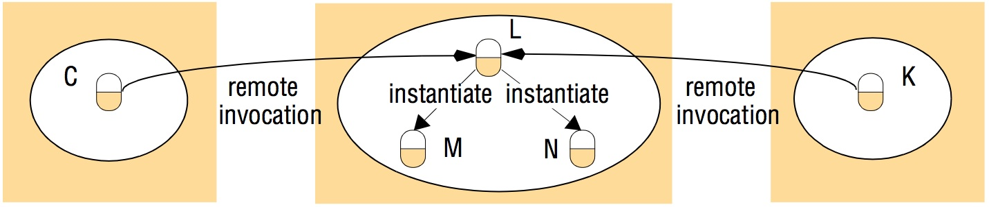
Distributed Object Concepts
Actions
  Actions can be performed on remote objects (objects in other processes)
  An action could be executing a remote method defined in the remote interface or creating a new object in the target process
  Actions are invoked using Remote Method Invocation (RMI)

Slide 18
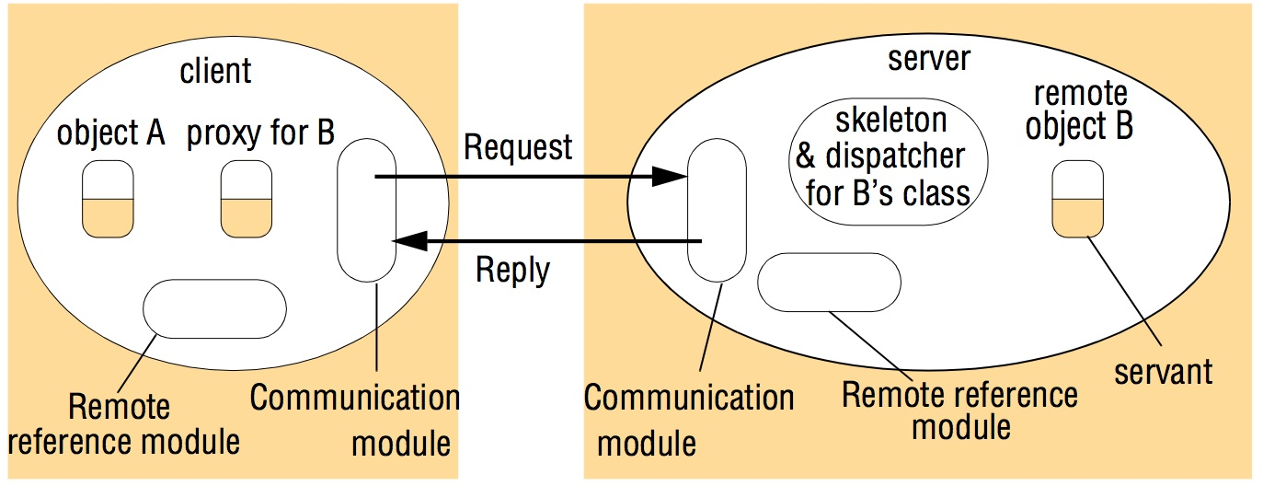
Implementation of RMI

Slide 19
Communication Module
The two cooperating communication modules carry out the request-reply protocol
It uses three fields from the message:
  Message type
  Request ID
  Remote object reference
It is responsible for implementing the invocation semantics
The server module queries the remote reference module to obtain the local reference of the object and passes the local reference to the dispatcher for the class

Slide 20
Remote Reference Module
Creates remote object references
Has a remote object table that records the correspondence between local object references in that process and remote object references (system-wide)
The remote object table contains an entry for each:
  Remote object reference held by the process
  Local proxy
Entries are added to the remote object table when:
  A remote object reference is passed for the first time
  When a remote object reference is received and an entry is not present in the table
For example, when a request message arrives, the table is used to find out which local object is to be invoked
Notes:
Servants are the objects in the process that receive the remote invocation (remote objects).

Slide 21
RMI Software
Software layer that lies between the application and the communication and object reference modules
Proxy: Plays the role of a local object to the invoking object. There is a proxy for each remote object which is responsible for:
  Marshalling the reference of the target object, its own method id and the arguments and forwarding them to the communication module
  Unmarshalling the results and forwarding them to the invoking object
Dispatcher: There is one dispatcher for each remote object class. Is responsible for mapping to an appropriate method in the skeleton based on the method ID
Skeleton: Is responsible for:
  Unmarshalling the arguments in the request and forwarding them to the servant
  Marshalling the results from the servant to be returned to the client

Slide 22
Implementing an RMI Application
Remote Interface
  Exposes the set of methods and properties available
  Defines the contract between the client and the server
  Constitutes the root for both stub and skeleton
Servant component
  Represents the remote object (skeleton)
  Implements the remote interface
Server component
  Main driver that creates, initializes, and makes available the servant
  Registers the servant with the binder
Client component
  Uses the binder to lookup for remote objects.
Compile source and generate stubs
  Client proxy/stub
  Server dispatcher and skeleton

Slide 23
The Binder
Client programs require a way to obtain the remote object reference of the remote objects in the server.
A binder is a service in a distributed system that supports this functionality.
A binder maintains a table containing mappings from textual names to object references.
Servers register their remote objects (by name) with the binder. Clients look them up by name.

Slide 24
Transparency
Although location and access transparency are goals for remote invocation, in some cases complete transparency is not desirable:
  Remote invocations are more vulnerable to failures
    They involve a network, potentially another computer
    There is always the chance that no result is received
    Clients making remote invocations should be able to recover from this situation
  The latency of a remote invocation is much larger than that of a local one. Programs making remote invocations should be able to take this into account so that they can:
    Minimize the number of remote invocations
    Abort a remote invocation that is taking too long
Therefore, many implementations provide location transparency but not complete access transparency. This enables the programmer to make optimization decisions

Slide 25
Java RMI
Client
Server
RemotObj proxy <implements RemoteInterface>
6. method1()
<Request over the network>
RemoteObj Dispatcher/
Skeleton
7. method1()
9. Return value
<Reply over the network>
RemoteObj
<implements RemoteInterface>
5. method1()
10. Return
value
8. return value
Client
Server
1. new RemoteObj()
4. Return RemoteObj proxy
RMI Registry
2. bind(“myRO”, RemoteObj)
3. lookup(“myRO”)
<“myRO”, Remote Ref. to RemoteObj>

Slide 26
Java RMI Example
Specify the Remote Interface
public interface IRemoteMath extends Remote {
double add(double i, double j) throws RemoteException;
double subtract(double i, double j) throws RemoteException;
}

Slide 27
Java RMI Example
Implement the Servant Class
public class RemoteMathServant extends UnicastRemoteObject implements IRemoteMath {
public double add ( double i, double j ) throws RemoteException {
return (i+j);
}
public double subtract ( double i, double j ) throws RemoteException {
return (i-j);
}
}

Slide 28
Java RMI Example
Implement the server
public class MathServer {
public static void main(String args[]){
System.setSecurityManager(new RMISecurityManager());
try{
IRemoteMath remoteMath = new RemoteMathServant();
Registry registry = LocateRegistry.getRegistry();
registry.bind("Compute", remoteMath );
System.out.println("Math server ready");
}catch(Exception e) {
e.printStackTrace();
}
}
}

Slide 29
Java RMI Example
Implement the client program
public class MathClient {
public static void main(String[] args) {
try {
if(System.getSecurityManager() == null)
System.setSecurityManager( new RMISecurityManager() );
LocateRegistry.getRegistry("localhost");
IRemoteMath remoteMath = (IRemoteMath) registry.lookup("Compute");
System.out.println( "1.7 + 2.8 = ” + math.add(1.7, 2.8) );
System.out.println( "6.7 - 2.3 = ” + math.subtract(6.7, 2.3) );
}
catch( Exception e ) {
System.out.println( e );
}
}
}

Slide 30
Java RMI Example
Running the Server and Client
  Compile Client and Server classes
  Develop a security policy file
    grant { permission java.security.AllPermission "", ""; };
  Start RMI registry
    rmiregistry &
  Start server
    java -Djava.security.policy=policyfile MathServer
  Start client
    java -Djava.security.policy=policyfile MathClient

Slide 31
Remote Procedure Call (RPC)
RPCs enable clients to execute procedures in server processes based on a defined service interface.
client process
server process
Request
Reply
client stub
server stub
procedure
procedure
client
service
program
Communication
Communication
procedure
module
module
dispatcher

Slide 32
Remote Procedure Call (RPC)
Communication Module
  Implements the desired design choices in terms of retransmission of requests, dealing with duplicates and retransmission of results
Client Stub Procedure
  Behaves like a local procedure to the client. Marshals the procedure identifiers and arguments which is handed to the communication module
  Unmarshalls the results in the reply
Dispatcher
  Selects the server stub based on the procedure identifier and forwards the request to the server stub
Server stub procedure
  Unmarshalls the arguments in the request message and forwards it to the service procedure
  Marshalls the arguments in the result message and returns it to the client

Slide 33

Summary

